Slide 1
Process Scheduling
Submitted to:
Rashed Mazumder
Submitted by:
Hridy Chowdhury(1931527042)
Ayesha Rahman(1931209)
Sabrina Akter Sabina(1931947042)
Aporbo Ghosh(1931458042)

Slide 2
Inroduction
The main purpose of this application is to compare and select the best algorithm for a particular set of input pertaining to the processes and in conclusion display the best algorithm. Process Scheduling is a key concept in computer multitasking, multiprocessing operating system and real‐time operating system designs. Scheduling refers to the way processes are assigned to run on the available CPUs, since there are typically many more processes running than there are available CPUs.

Slide 3
Objectives
The process scheduling is the activity of the process manager that handles the removal of the running process from the CPU and the selection of another process on the basis of a particular strategy.
Process scheduling is an essential part of a Multiprogramming operating systems. Such operating systems allow more than one process to be loaded into the executable memory at a time and the loaded process shares the CPU using time multiplexing.

Slide 4
Alogorithm’s Criteria
Any Process scheduling algorithm relies on the following criteria. They are:
CPU Utilization: CPU utilization refers to a computer's usage of processing resources, or the amount of work handled by a CPU.
Throughput: Throughput refers to the performance of tasks by a computing service or device over a specific period. It measures the amount of completed work against time consumed and may be used to measure the performance of a processor, memory and/or network communications.
Response time : Response time is the time from the arrival of a request up until the first response is produced.
Turnaround Time: The time interval from the time of arrival of a process to the time of completion is the turnaround time. Total turnaround time is calculation is the sum of the time periods spent waiting to get into memory, waiting in the ready queue, executing on the CPU, and doing I/O.
Waiting Time: The waiting time is not the measurement of time when a process executes or does I/O completion; it affects only the amount of time of submission of a process spends waiting in the ready queue. We keep average waiting time should be less.

Slide 5
First come first serve
Advantages:
Simple
Easy to implement
Disadvantages:
Non preemptive, short processes at the back of queue have to wait too long

Slide 6
Shortest job First
Advantages:
Minimizes average wait time.
Disadvantages:
Non Preemptive
Requires future knowledge of burst time.
Can lead to starvation as long jobs may never be scheduled.

Slide 7
Round Robin
Advantages:
Jobs get fair share of CPU (No starvation)
CPU utilization is almost 100% as the CPU never gets idle.
Disadvantages:
If the time quantum is too short, then too much process switching will take place and design will become slow.
If time quantum too large then it may act as FCFS.

Slide 8
Priority Based (PB)
Advantages:
This provides a good mechanism where the relative importance of each process maybe precisely defined.
Disadvantages:
If high priority processes use up a lot of CPU time, lower priority processes may starve and be postponed indefinitely.

Slide 9
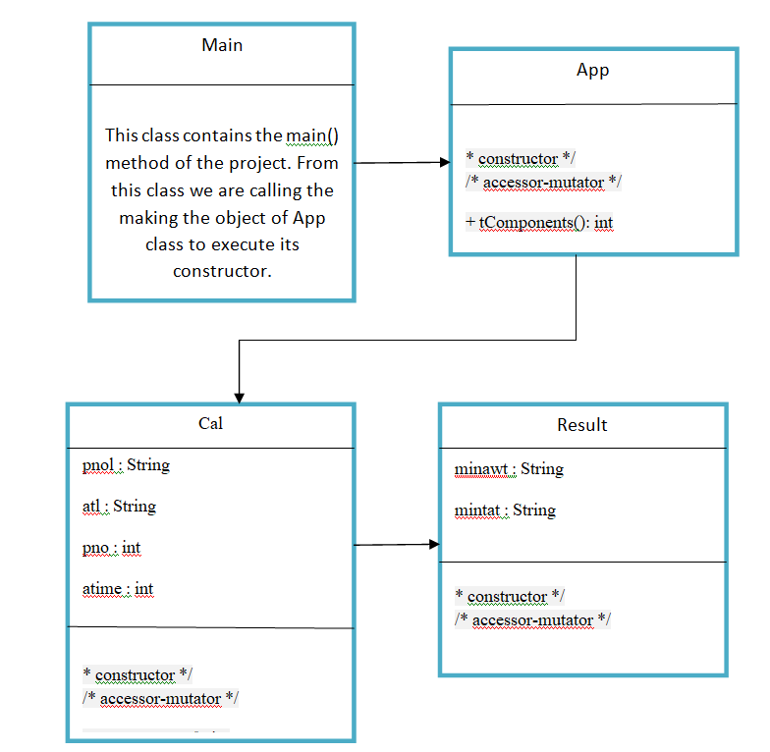
UML Diagram

Slide 10

Scheduler Performance Evaluation

Slide 11
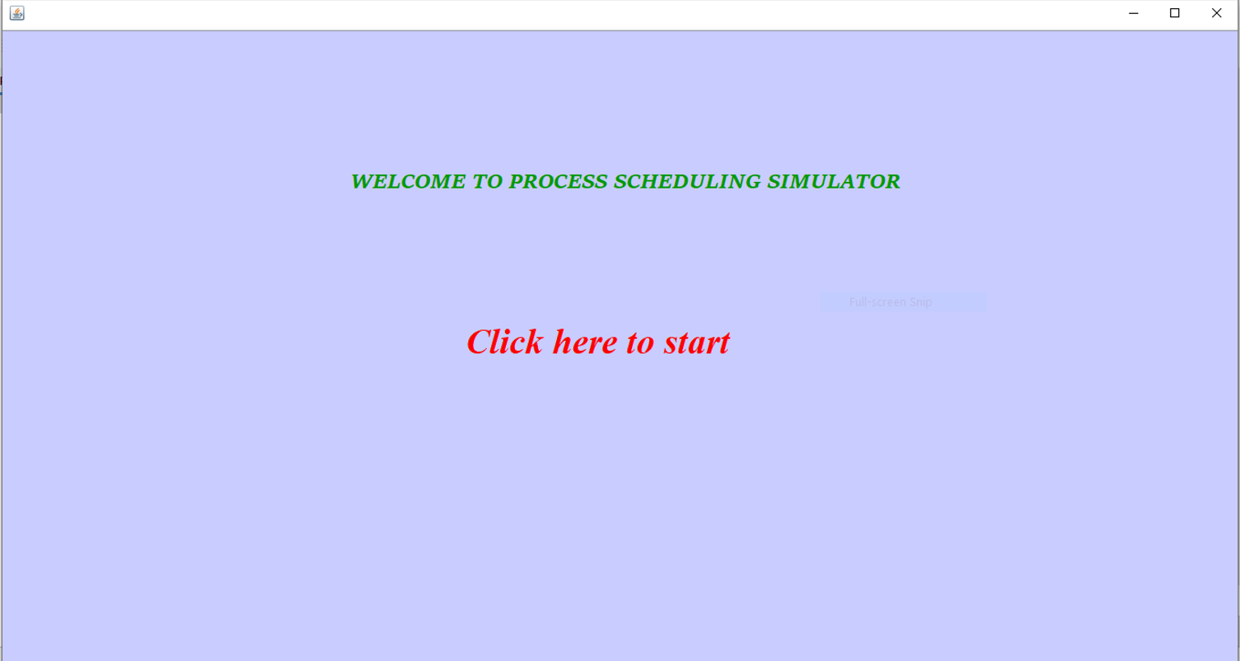

Slide 12
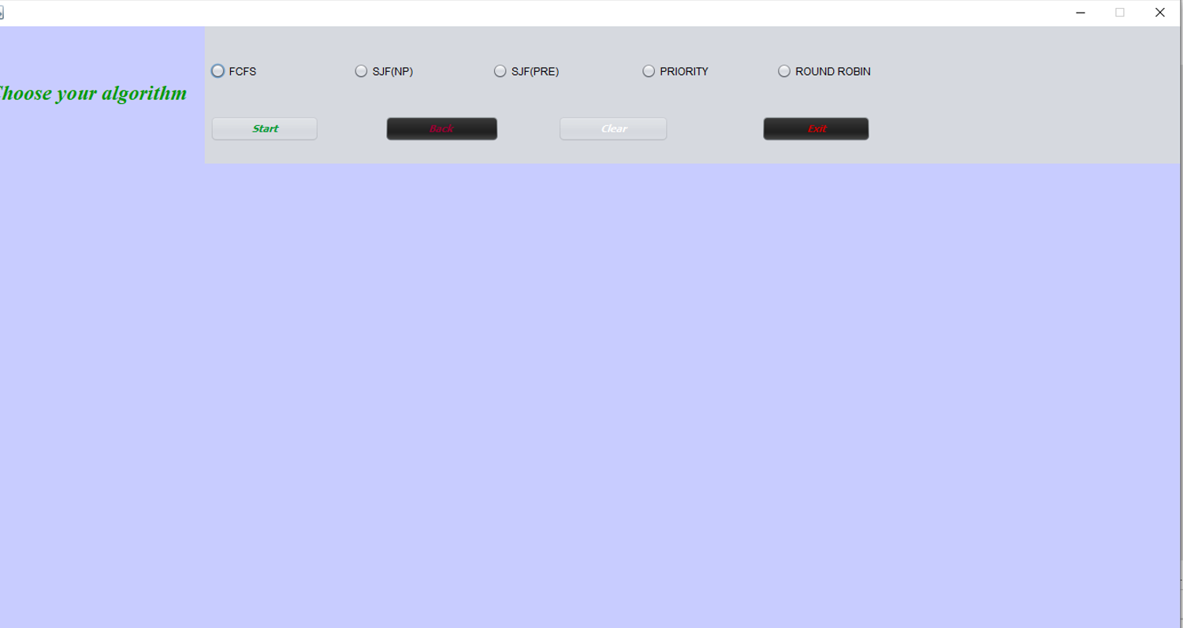

Slide 13
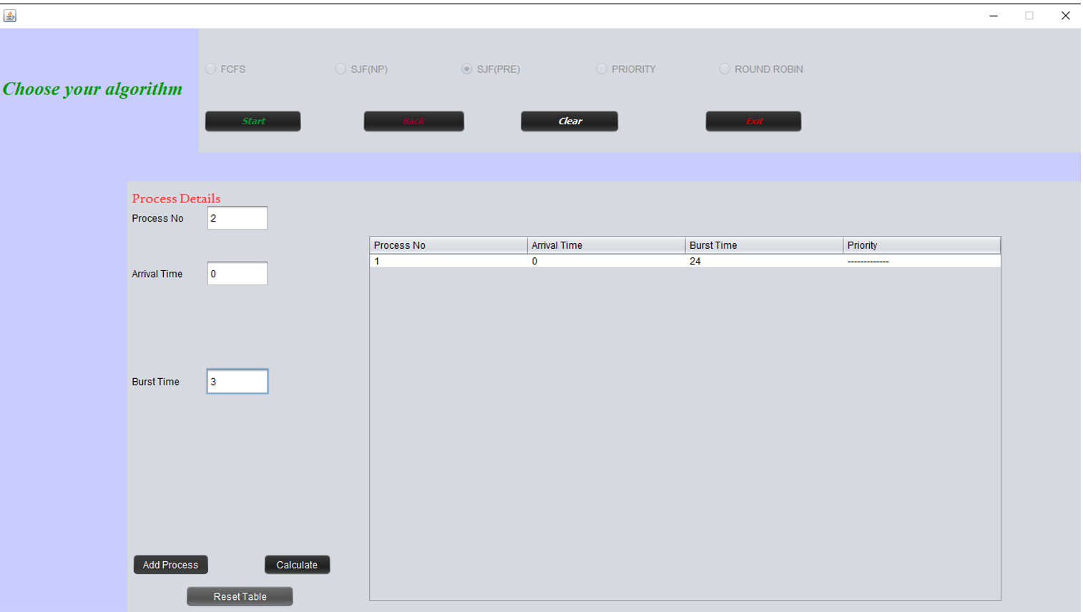

Slide 14
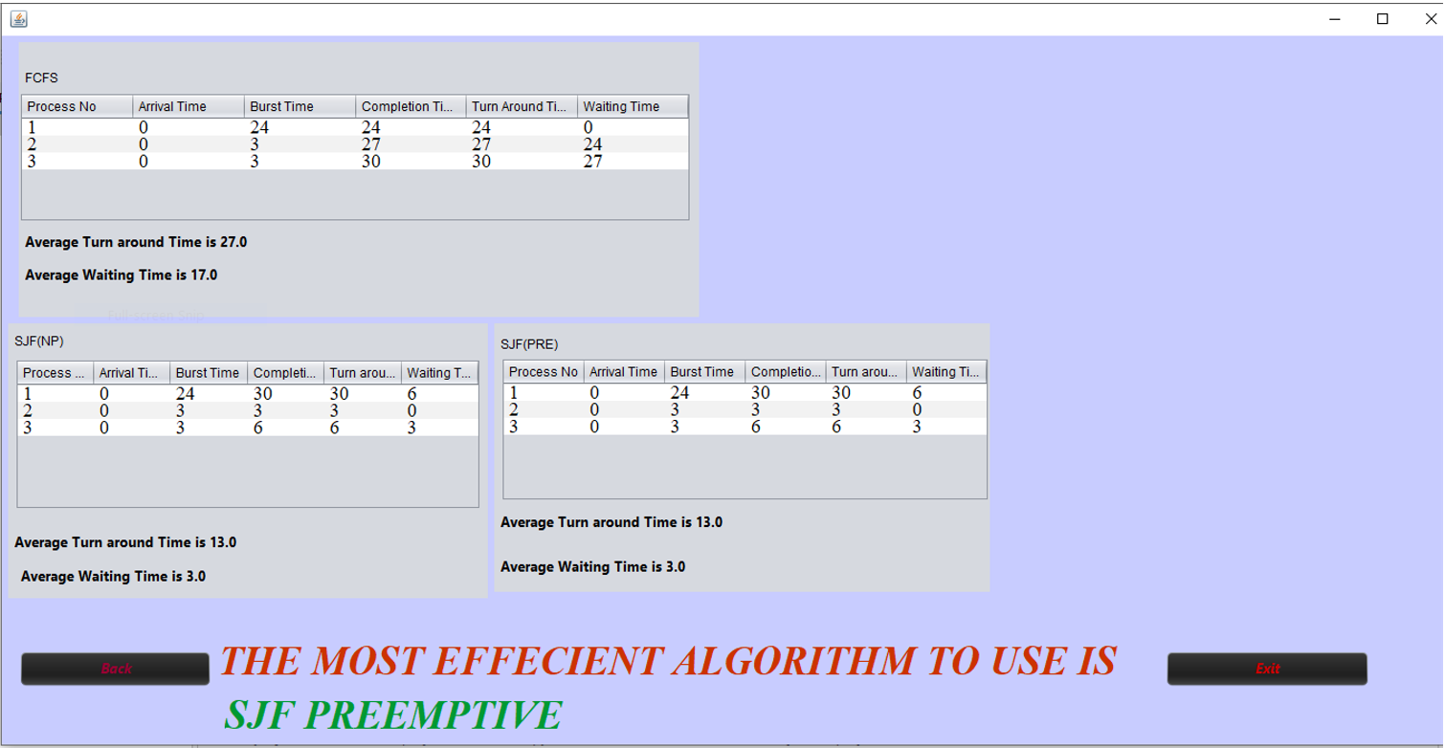

Slide 15
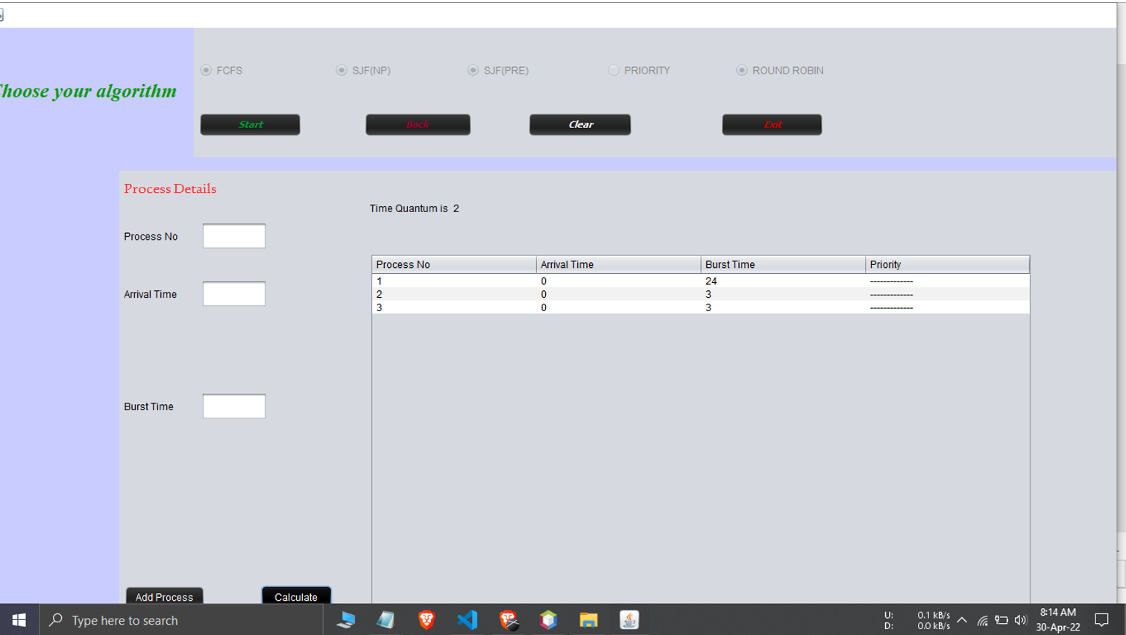

Slide 16
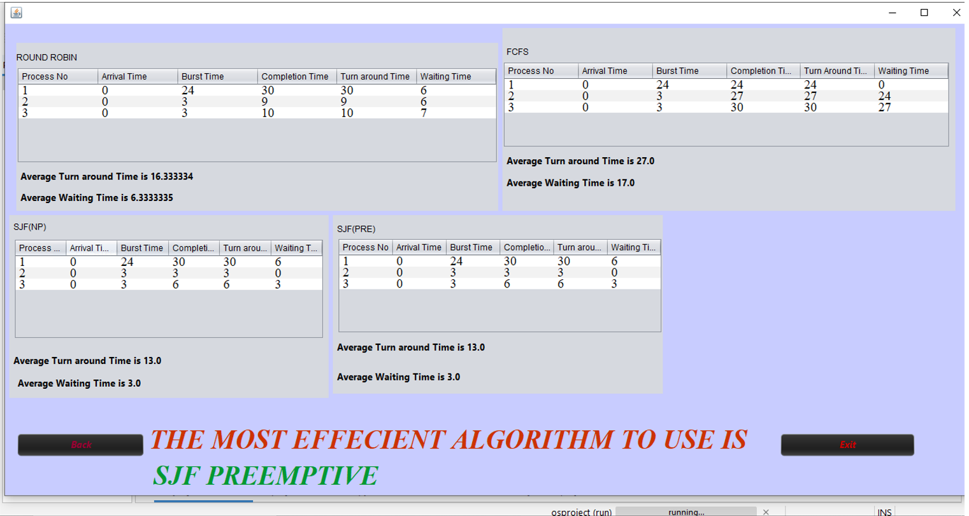

Slide 17
Input stage maps input:
Deadline
Priority.
Processing Stage:
Collection of rules in the form of IF-THEN statements.
Decisions are based on testing all the rules in Fuzzy Inference Subsystem.
eg: Mamdani FIS, Sugeno FIS.

Slide 18
THANK YOU

